Slide 1
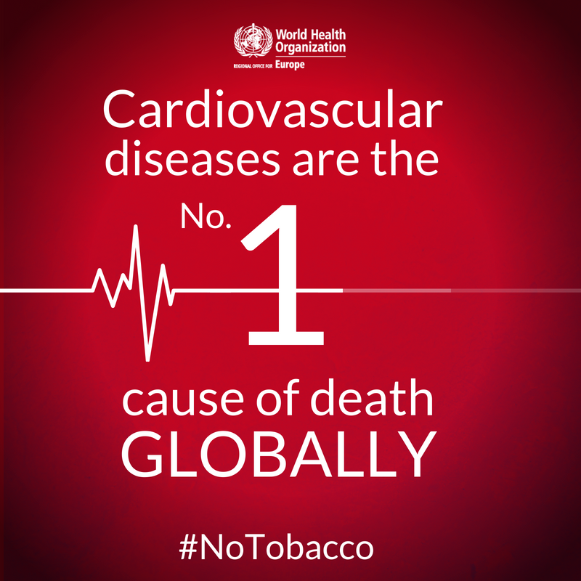

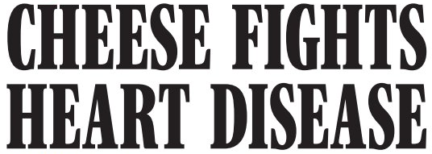


Notes:
https://financialpost.com/opinion/book-excerpt-lipophobia-and-the-bad-science-diet
http://content.time.com/time/covers/0,16641,19810601,00.html

Slide 2
Risk factors for heart disease in different locations
by
Kalvin Dobler, Nicolas Huber, Nathalie Guttmann
Introduction to Data Science 2021

Slide 3
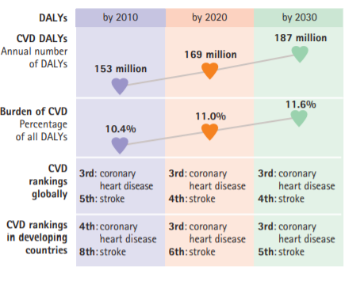
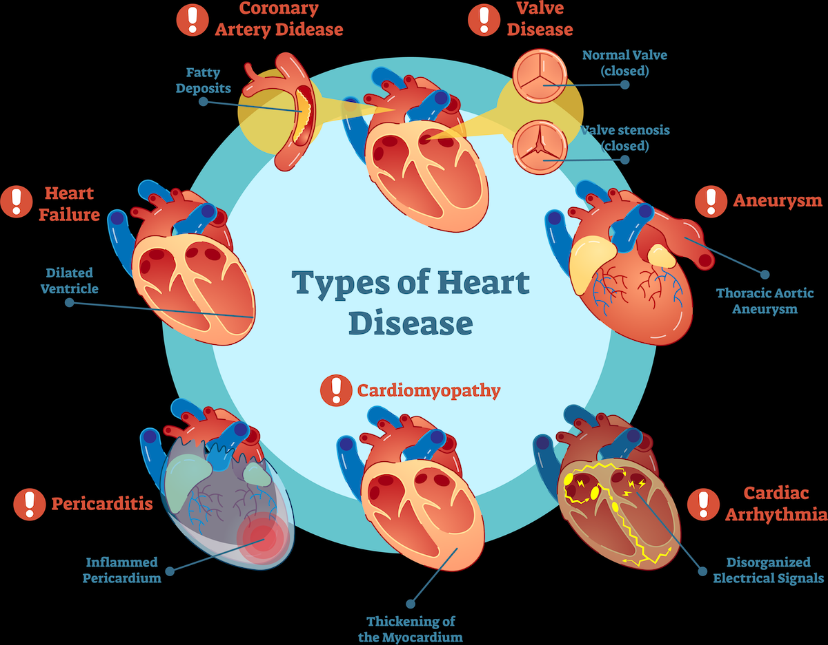
Cardiovascular disease (CVD)
Nr. 1 worldwide for mortality and morbidity
Mostly in low and middle-income countries
High- socio-economic burden
Most CVDs losses: ischemic heart disease and stroke
Notes:
-2025: 621.5 billion of$ direct medical cost un USA
-2030: 818.1 billion $
-it includes cardiovascular disease, CHD, coronary heart disease; HF, heart failure
https://www.udmi.net/cardiovascular-disease-risk/

Slide 4
Research questions
Risk factors predicting cardiovascular diseases?
Meaningful different levels of heart diseases?
Difference between locations?
Notes:
pool

Slide 5
Dataset
Name: Heart Disease Data Set
Source: UCI Machine Learning Repository
Time: 1998
Location: Hungary, Switzerland (incl. Zürich and Basel), Cleveland, Long Beach
Disease: 0 : healthy, 1-4: different levels of heart disease
Attributes (75): sex, age, chest pain location, smoking….

Slide 6
Workflow
Pre-processing: removing missing values
Data visualization: correlation between features
Feature selection: Random Forrests
Dimensionality reduction: t-SNE, UMAP, Autoencoders
Classification: logistic regression, multinomial logistic regression, naive Bayes, SVM, KNN, neural networks
Performance measurement: Confusion matrix, ROC curve (incl. AUC)
Notes:
UMAP

Slide 7
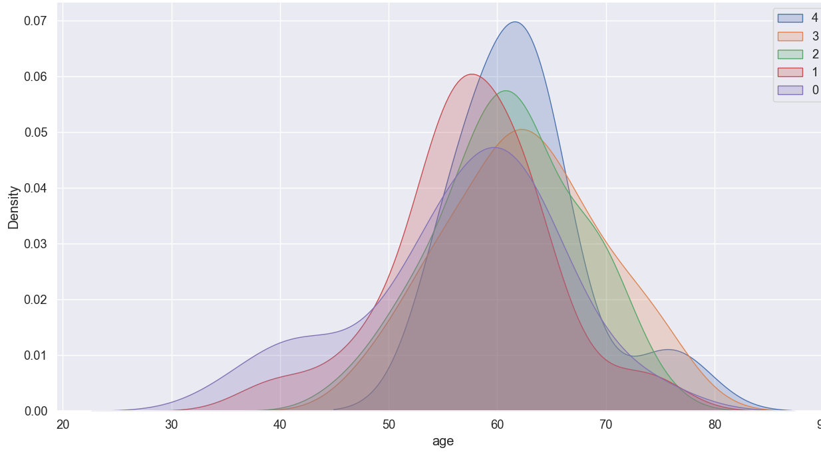
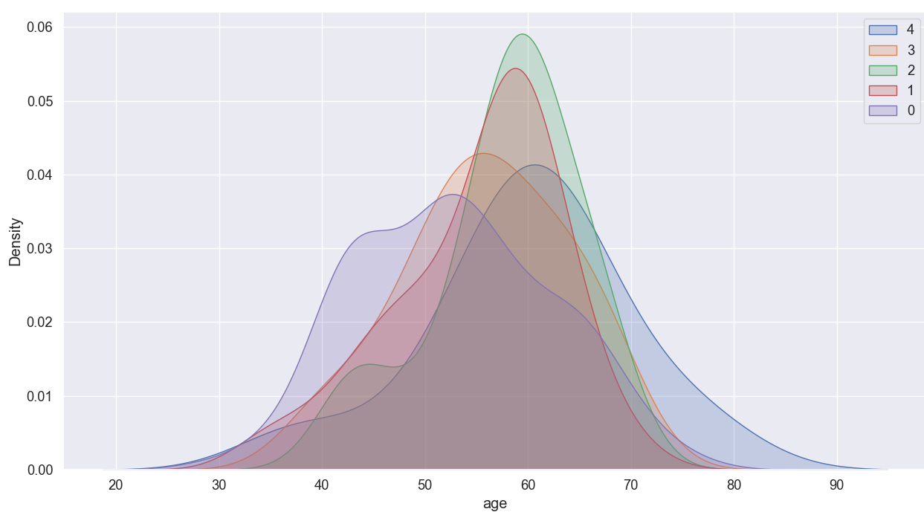
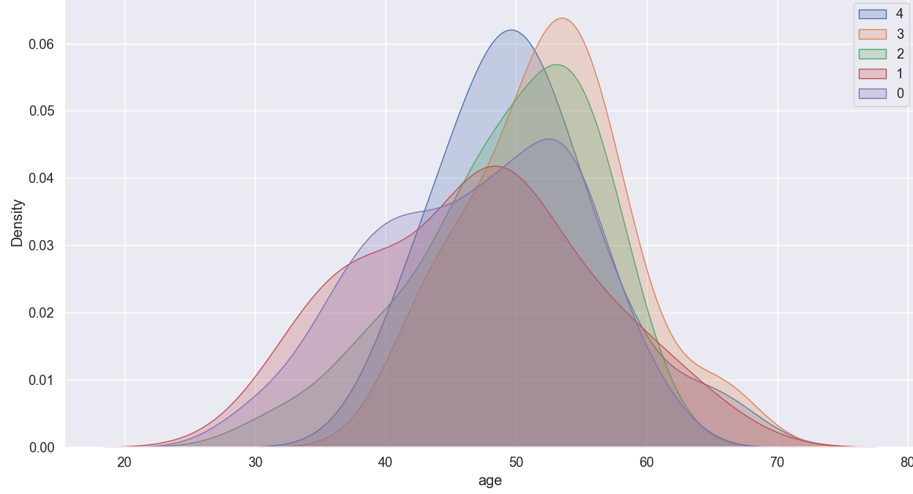
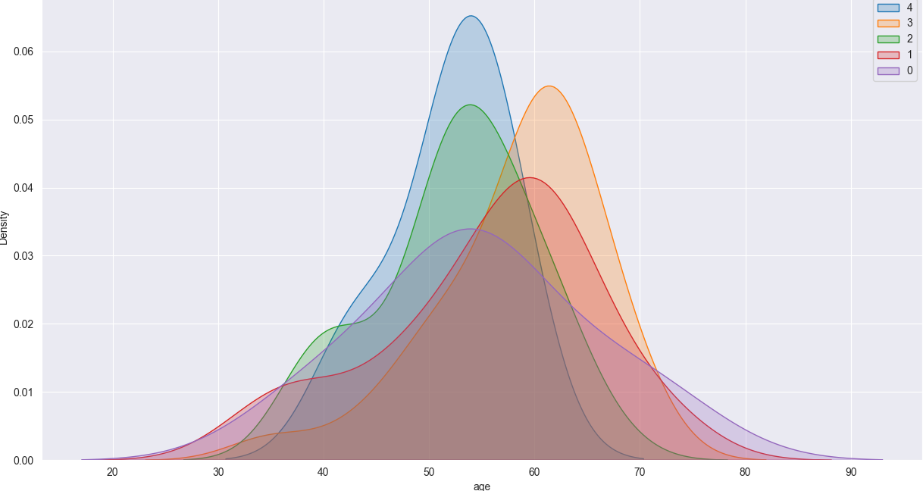
Distribution of age for the type of disease
Vancouver
Cleveland
Hungary
Switzerland
Notes:
Cleveland: 0: shifted disitrubtion
-mean 50-60 for all location
-subjective->most patients between 50-60, difficult to differentiate between healthy and sick people

Slide 8
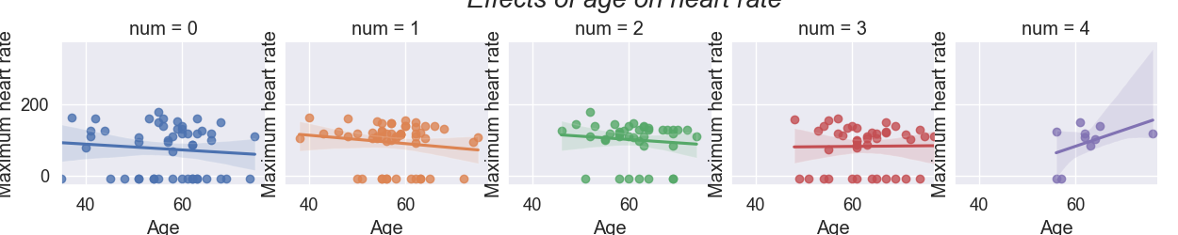
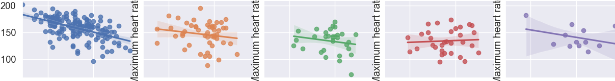
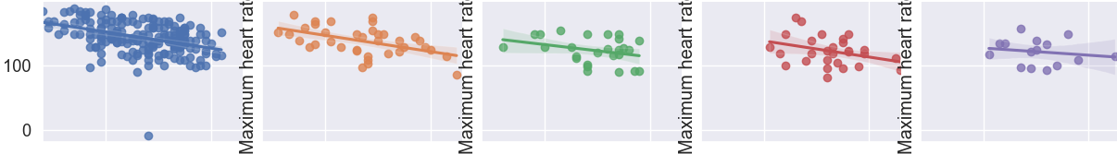
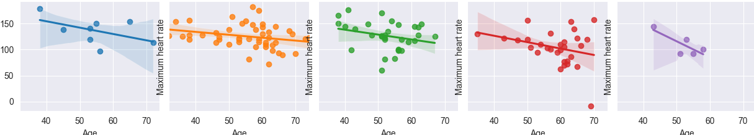
Effect of age on max. heart rate
Vancouver
Cleveland
Hungary
Switzerland
Notes:
switzerland.: few points

Slide 9
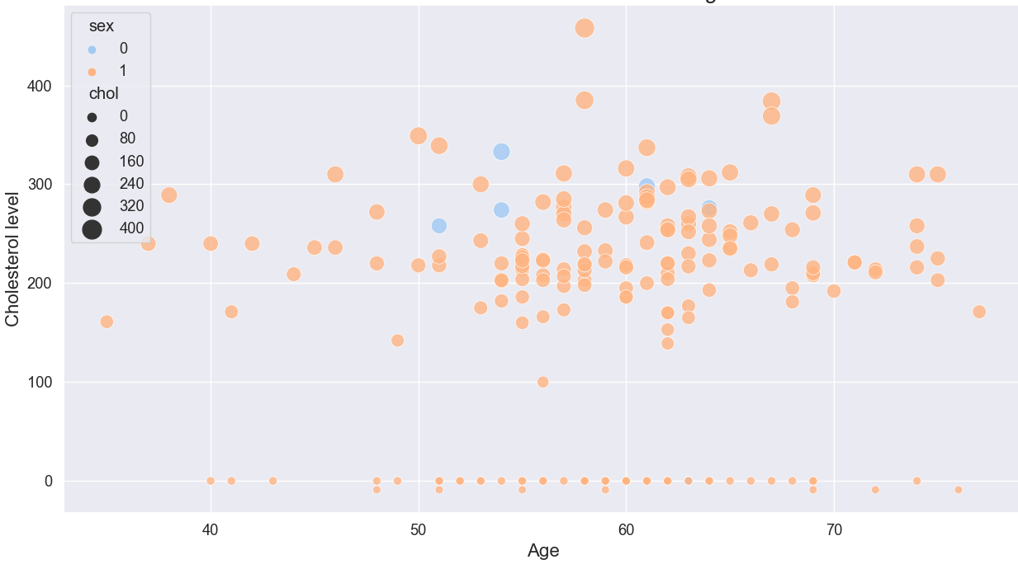
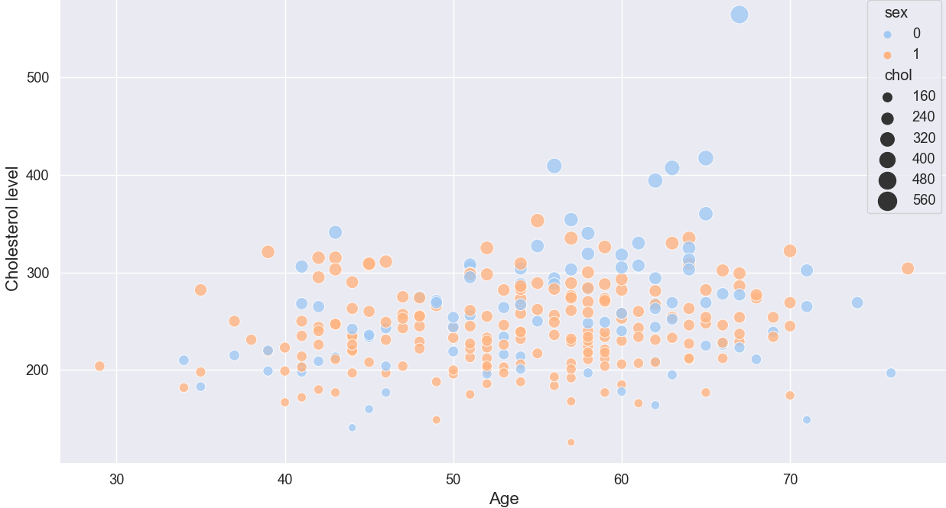
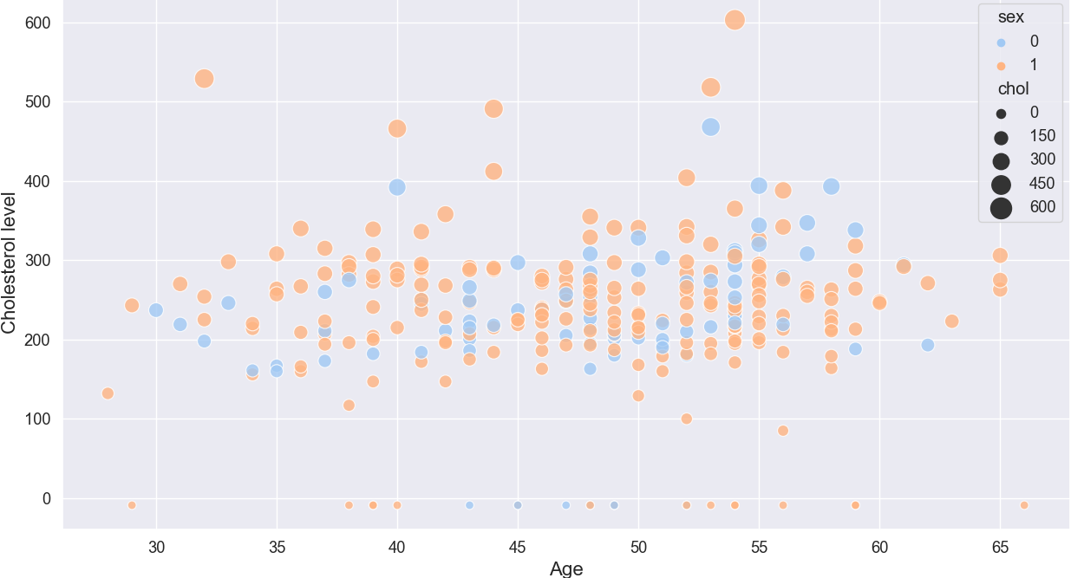
Cholesterol levels
Vancouver
Cleveland
Hungary
Notes:
1=male, 0=female

Slide 10
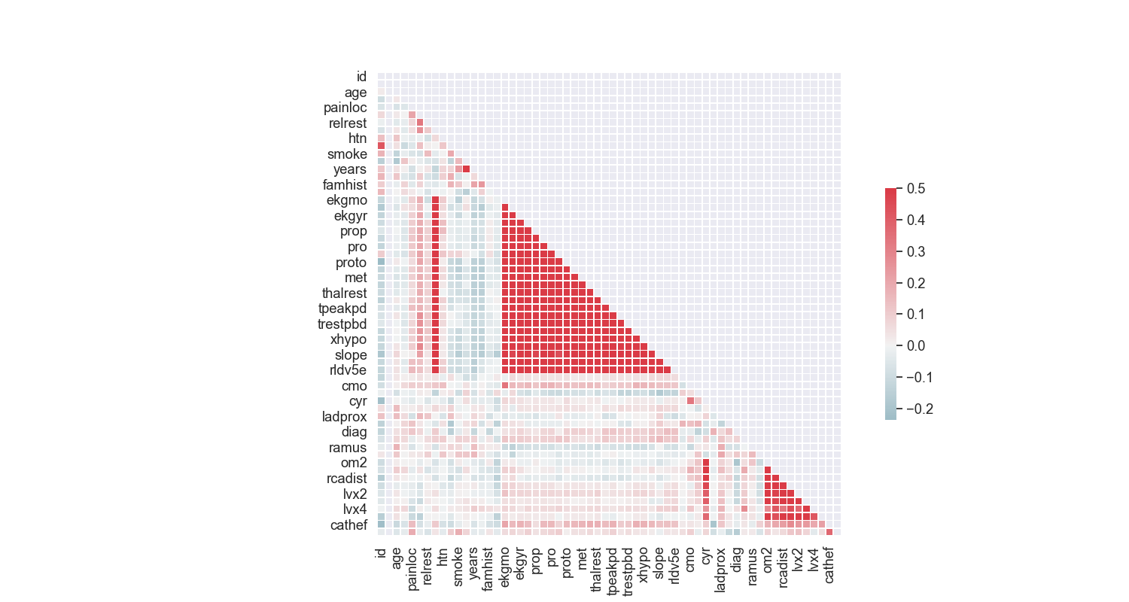
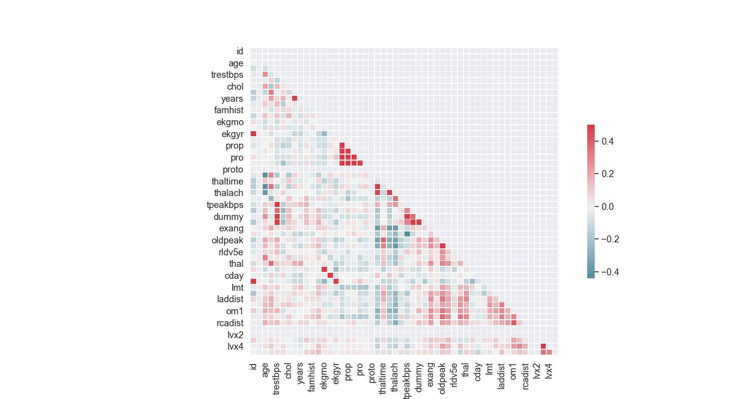
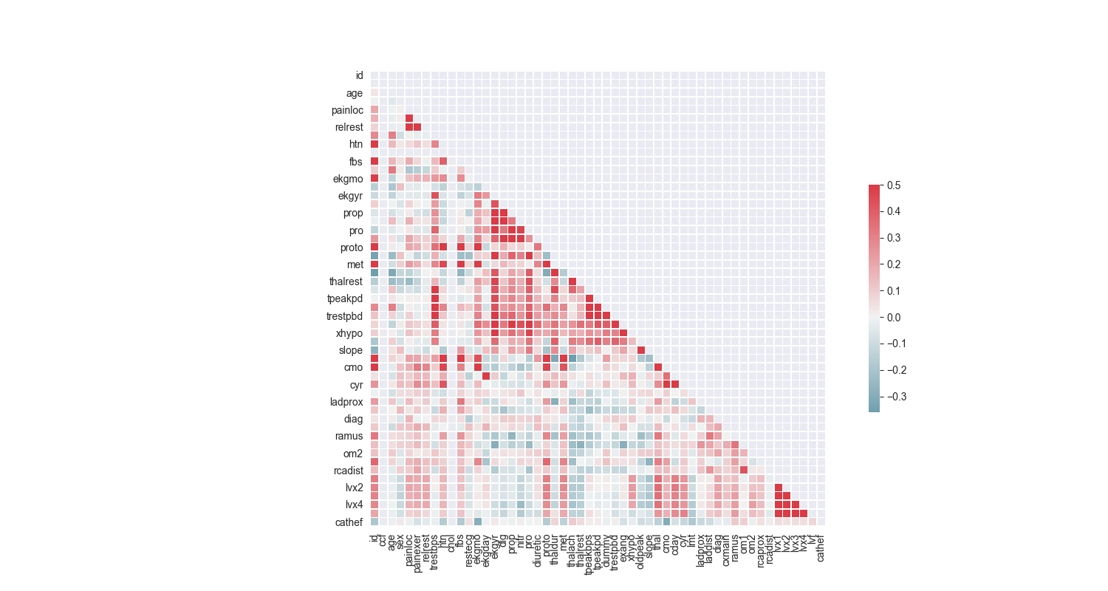
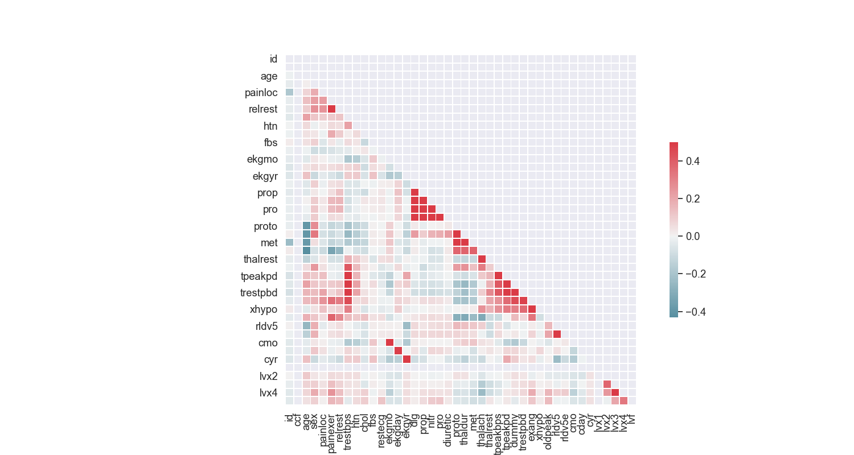
Correlation between features
Vancouver
Cleveland
Hungary
Switzerland

Slide 11
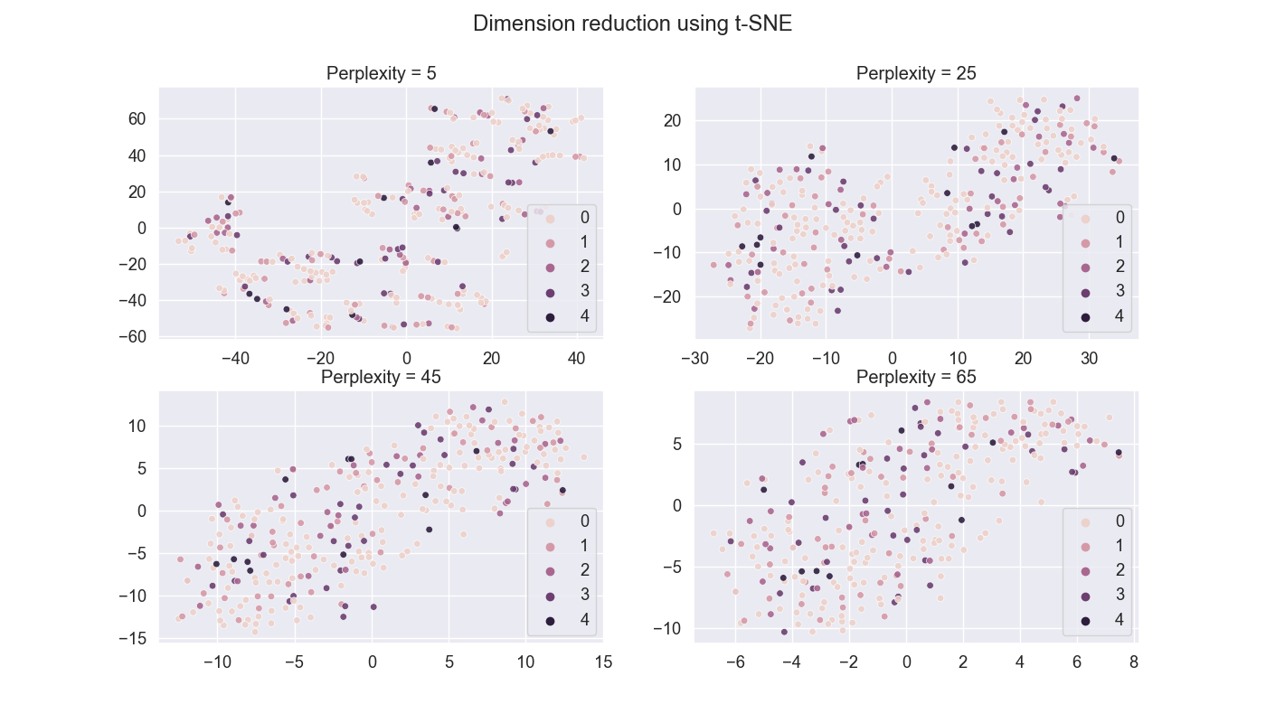
t-SNE
Cleveland
No pattern for all locations-> UMAP and autoencoders
Notes:
Show only cleveland-> no pattern , used algorithm, UMAP and autoentcoders
Explain perplexitiy

Slide 12
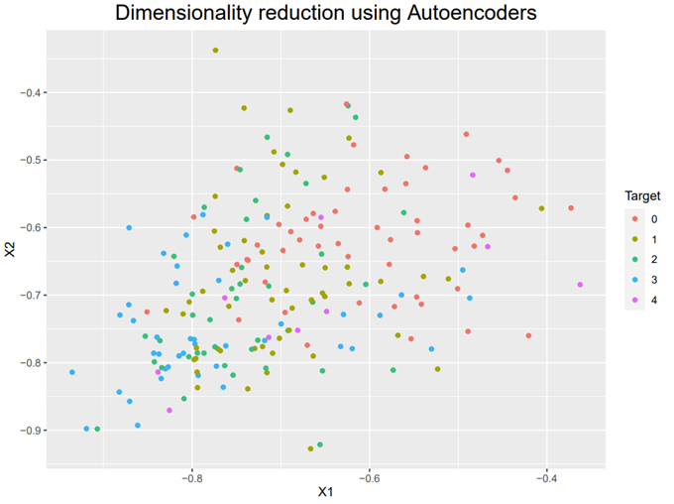
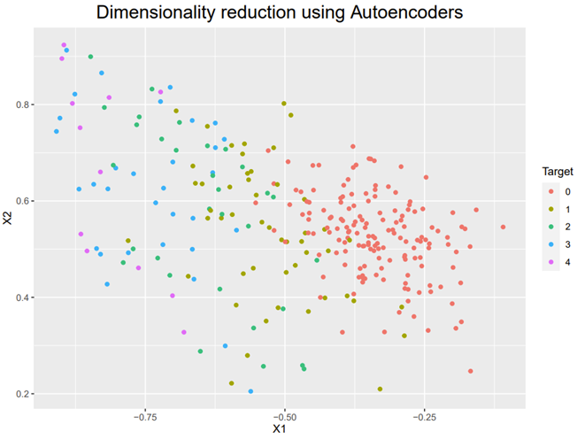
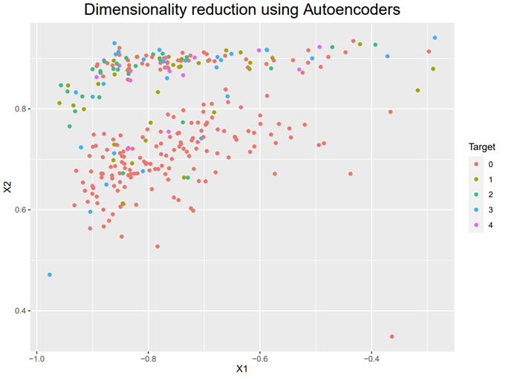
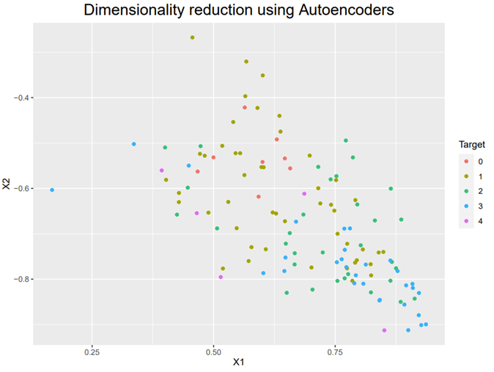
Autoencoders
Vancouver
Cleveland
Hungary
Switzerland
Notes:
We see some clustersfro cleveland, vancouver and hungary
-neural network, hard to give information about feature, how was it seprated, how
-used 25 features
-visul
-

Slide 13
Top 5 most important risk factors
Notes:
Random forrest to chosee the 25 most important features to explain 80 % importancy of feature and then select 5 most important one
-remove some feautres, like iD and LVx4 etc, which irrelevant-> because of small dataset those have more weight

Slide 14
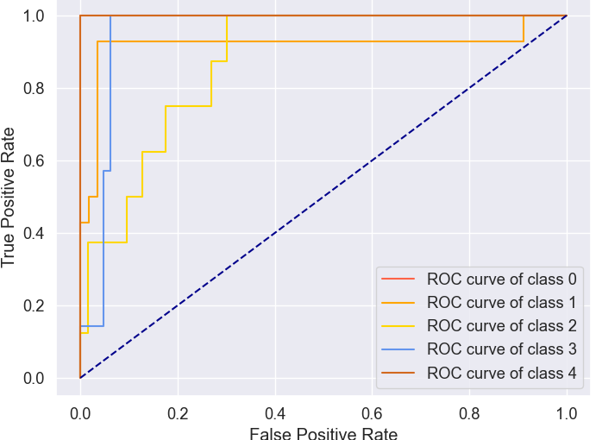
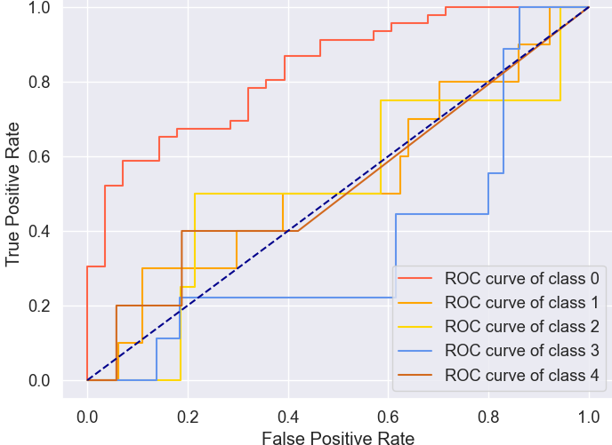
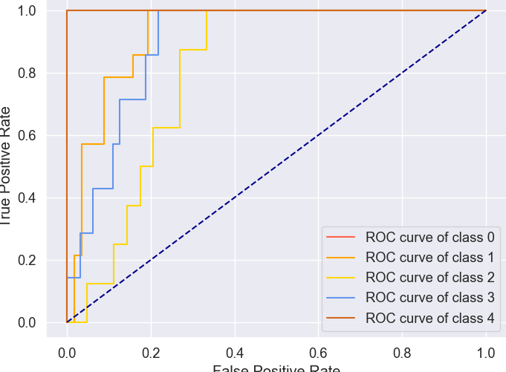
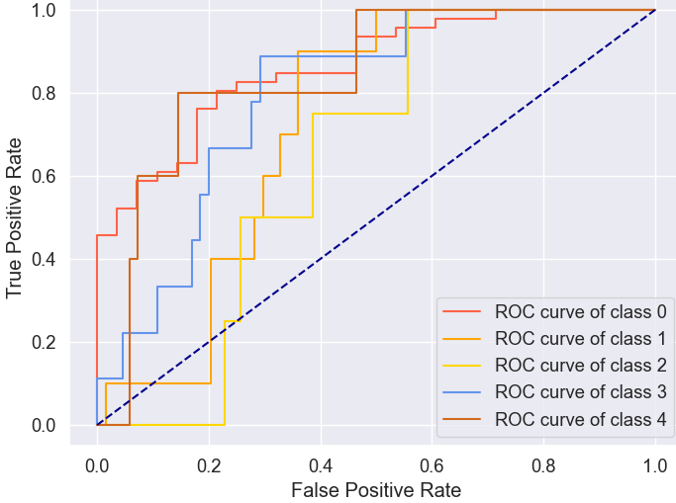
ROC curve
Cleveland: Logistic Regression
Hungary: Logistic Regression
Cleveland: naive Bayes
Hungary: naive Bayes
Notes:
Add switzerland

Slide 15
Performance measurement

Slide 16
Conclusion
Variation in accuracy between methods for prediction of heart disease
For some dataset: prediction not good
Difficulty to differentiate the different targets
  Merge all levels for heart disease or more patients data for each targets
Minor differences between locations
Notes:
It would be interesting to have more different location japan/ asia/-> different locations
Maybe difference between levels to soft

Slide 17
Limitations and Outlook
Old dataset
Switzerland dataset unbalanced
Missing description of features
Missing (important) features (e.g cholesterol in CH)
Some selection of features senseless
Fine tune models generators
Use of more features
Find updated datasets

Slide 18
References
D’Agostino R. B., Vasan R. S., Pencina M. J., Wolf P. A., Cobain M., & Massaro J. M., Kannel W. B. (2008). General Cardiovascular Risk Profile for Use in Primary Care. Circulation, 117(6), 743-753. doi:10.1161/CIRCULATIONAHA.107.699579
Dalen, J. E., Alpert, J. S., Goldberg, R. J., & Weinstein, R. S. (2014). The epidemic of the 20(th) century: coronary heart disease. The American journal of medicine, 127(9), 807-812. doi:10.1016/j.amjmed.2014.04.015
Dinu, M., Pagliai, G., & Sofi, F. (2017). A Heart-Healthy Diet: Recent Insights and Practical Recommendations. Current cardiology reports, 19(10), 95. doi:10.1007/s11886-017-0908-0
Kreatsoulas, C., & Anand, S. S. (2010). The impact of social determinants on cardiovascular disease. The Canadian journal of cardiology, 26 Suppl C(Suppl C), 8C-13C. doi:10.1016/s0828-282x(10)71075-8
Monteiro, C. A., Moubarac, J.‐C., Cannon, G., Ng, S. W., & Popkin, B. (2013), Ultra-processed products are becoming dominant in the global food system. obesity reviews, 14(S2), 21-28. doi:10.1111/obr.12107
WHO. (2010). Global status report on noncommunicable diseases 2010 (). Retrieved April 02, 2021 from
https://apps.who.int/iris/bitstream/handle/10665/44579/9789240686458_eng.pdf;jsessionid=842AF06136BEC4C69DEFE189288DFED6?sequence=1
WHO. (2017). Cardiovascular diseases (CVDs). Retrieved April 02, 2021 from https://www.who.int/news-room/fact-sheets/detail/cardiovascular-diseases-(cvds)
WHO. (2020). The top 10 causes of death. Retrieved April 02, 2021 from https://www.who.int/news-room/fact-sheets/detail/the-top-10-causes-of-death
https://twitter.com/who_europe/status/1153277944531488768
http://content.time.com/time/covers/0,16641,19810601,00.html
https://feedabrain.com/change-of-heart-on-fat/
https://twitter.com/skynews/status/936351789464551426

Slide 19
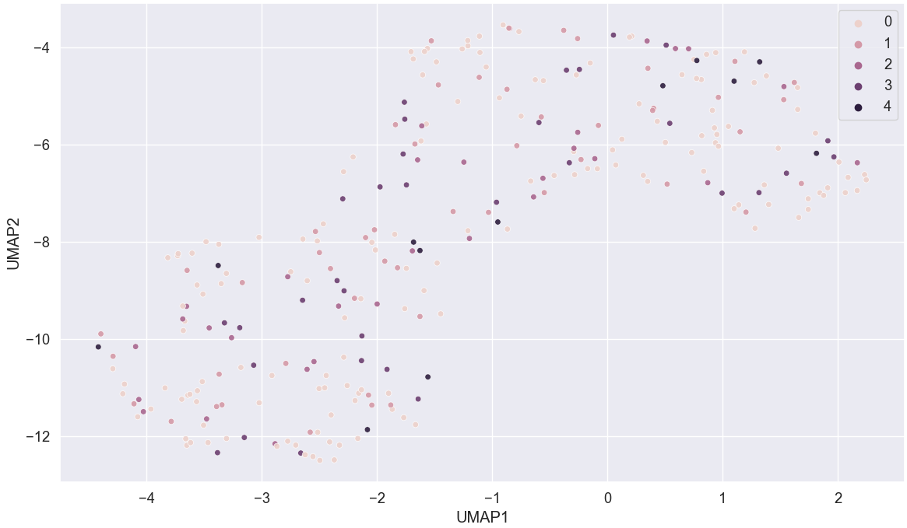
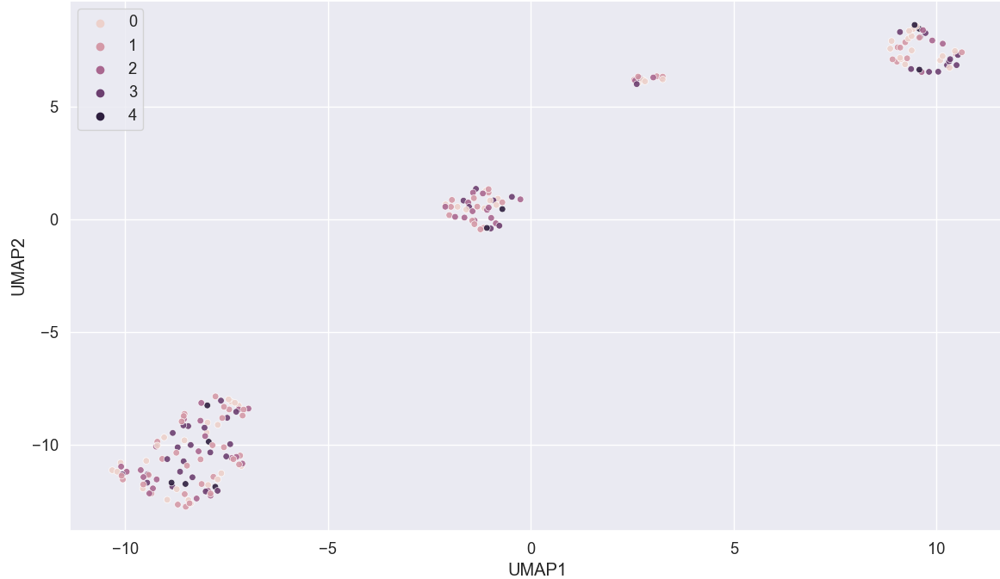
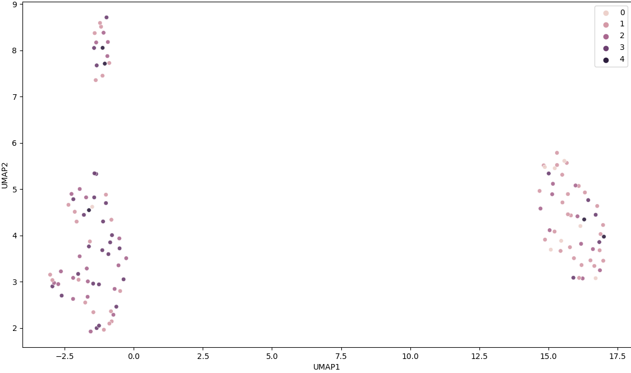
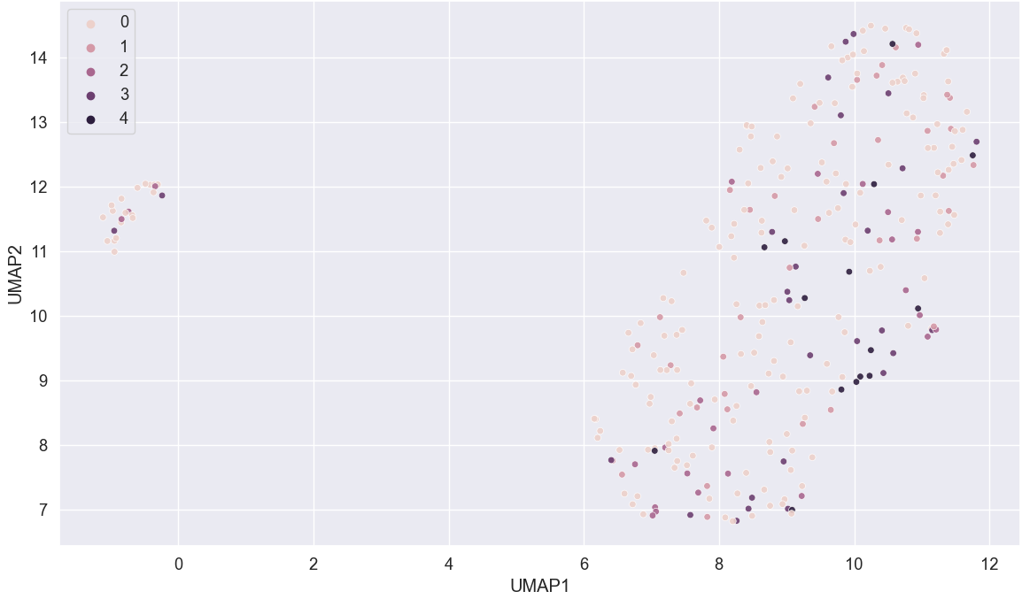
UMAP
Cleveland
Vancouver
Switzerland
Hungary

Slide 20
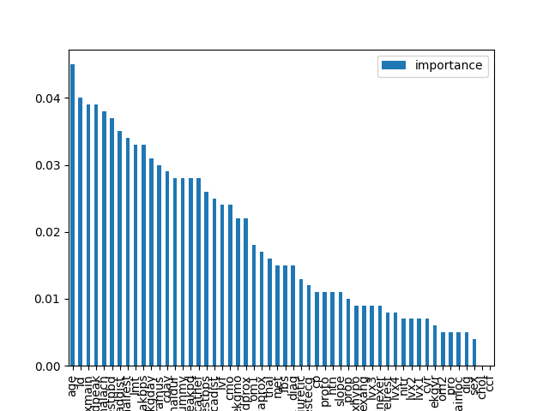
Feature importance switzerland

Slide 21
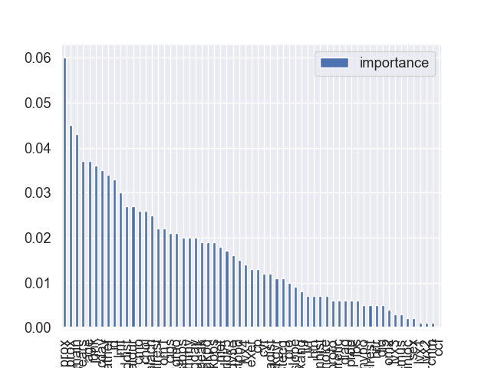
Feature importance vancouver

Slide 22
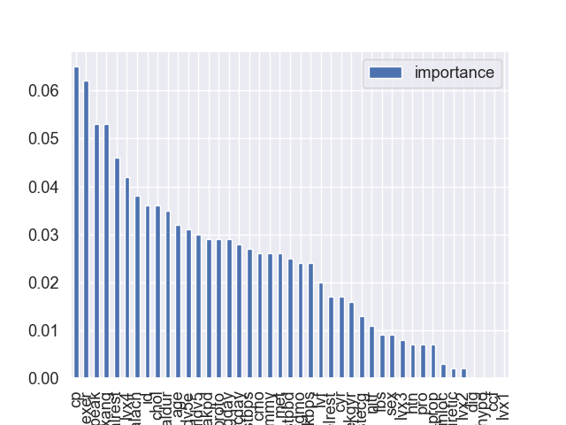
Feature importance hungary

Slide 23
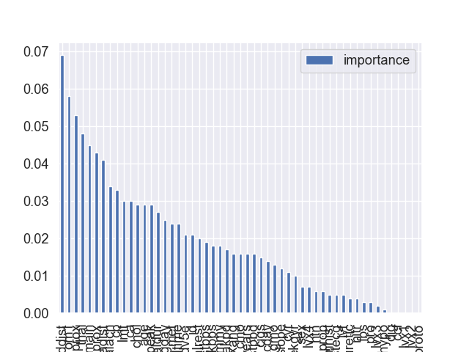
Feature importance cleveland

Slide 24

UMAP vancouver

Slide 25

Cholesterol vancouver

Slide 26

Cleveland roc 14

Slide 27
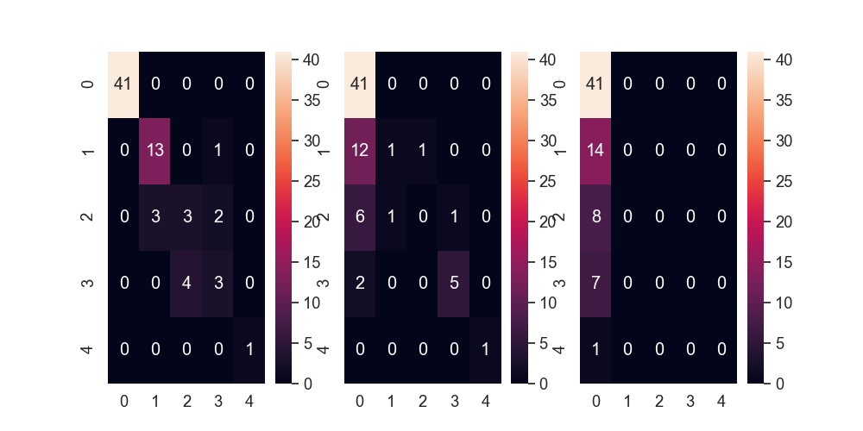
Confusion matrices SVC cleveland

Slide 28
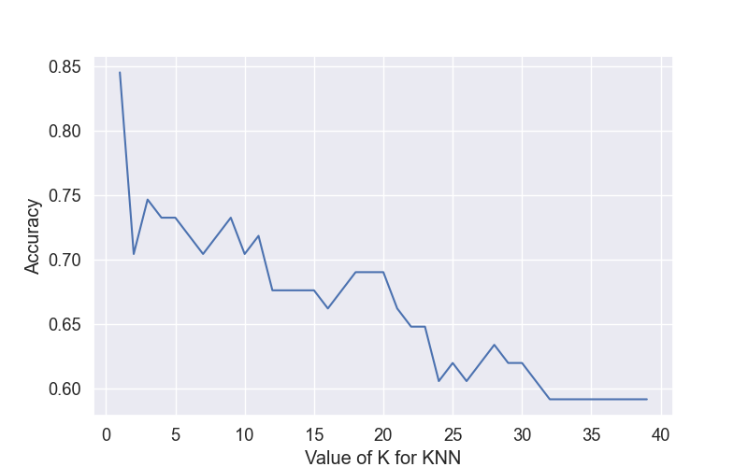
KNN cleveland

Slide 29
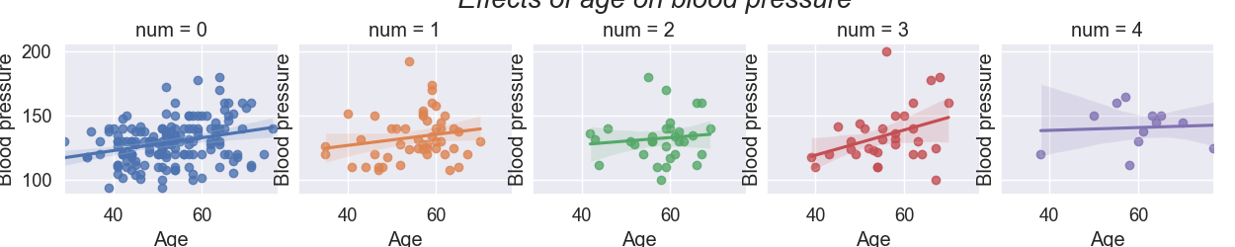

celveland

Slide 30

https://www.berelianimd.com/blog/i-cant-believe-its-not-butter-thats-been-clogging-my-arteries-for-the-last-60-years

